Slide 1
Industrial Engineering & Management lesson(9)

Slide 2
2.1.1.1 Turnover Ratio
This is a rapid, simple method for estimating the fixed capital investment but is one of the most inaccurate. The turnover ratio is defined as:

Slide 4
Example (5) : Problem Statement: Estimate the fixed capital investment for a 1500 ton/day ammonia plant using the turnover ratio. The current gross selling price of ammonia is $150/ton. The plant will operate at a 95% stream time. Solution:

Slide 5
2.2.1.2 Fixed Investment per Annual Ton of Capacity
Fixed capital investments may be calculated in an approximate manner using this method. The data for this method are often in the open literature or from information that will allow one to calculate this information. Chemical Week or Hydrocarbon Processing are potential sources.

Slide 7
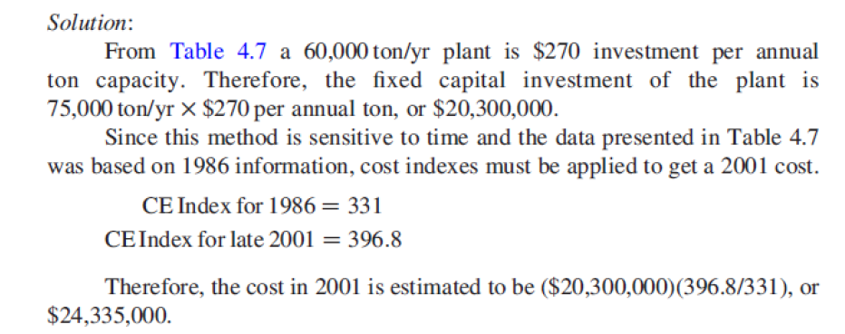
Example (5): Estimate the fixed capital investment of a 75,000 ton/yr maleic anhydride plant using the data for fixed investment per annual ton capacity in Table

Slide 8
2.2.1.3 Seven-Tenths Rule
It has been found that cost-capacity data for process plants may be correlated using a logarithmic plot similar to the 0.6 rule. Remer and Chai have compiled exponents for a variety of processes and most are between 0.6 and 0.8. The use of an average value 0.7 is the name of this method. Table 4.8 and Appendix E contain appropriate data. The equation is

Slide 9
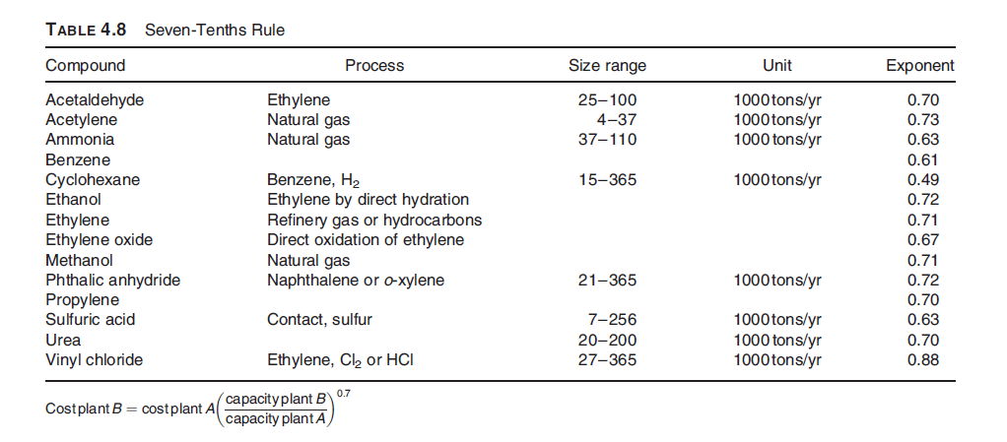

Slide 10
